Slide 1
Software Testing and Quality Assurance
Team:
ARPIT parikh
Apoorva Channankaiah
Austin Moon

Slide 2
Final Payment Calculator
Final payment calculator is a tool desired for international consumers who buy goods and pay with international credit or debit cards.
The main goal of Final Payment Calculator is that international buyers will get an idea of how much money they will pay in their international currency.
The tool helps buyers to identify the amount they will pay after calculating discount, tax, tip, and currency exchange.

Slide 3
System Requirements
The tool outputs the final amount after calculating discount, sales tax, gratuity, and currency exchange
The user provides information about the following:
Item/service price and its currency.
Discount.
State or city sales tax.
How much gratuity they want to provide.
The currency to be used for payment.
The user may provide discount or gratuity in percentage or by providing fixed amount.
The tool must provide reliable real-time currency conversion for some currencies including US dollar.
The user will not worry about how much is the currency exchange rate.
The user may or may not use all features in the tool in one calculation; for example, some situations may not include discounts or gratuity.
The interface should provide great user experience regarding usability.

Slide 4
Testing Tool
JUnit
It is framework for writing, running, and test in Java.
It is Regression Testing Framework.
It is easily integrated with Eclipse.
Features :Test suites, Test Runners.
Test suites: it is few unit test cases and runs them together. In JUnit, both @RunWith and @Suite annotation are used to run the suite test.
Test Runners: It is used for executing the test cases.

Slide 5
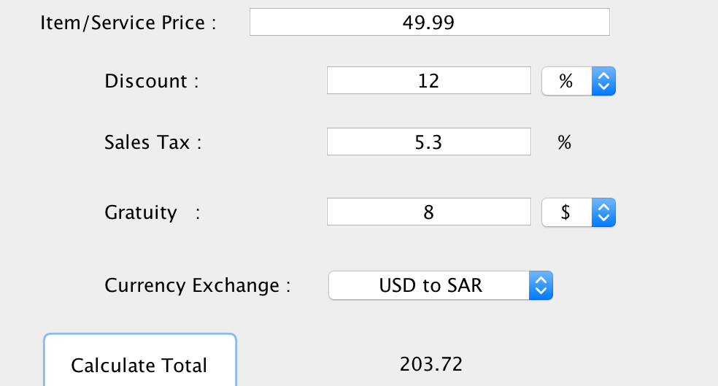
Screen Shots of tool

Slide 6
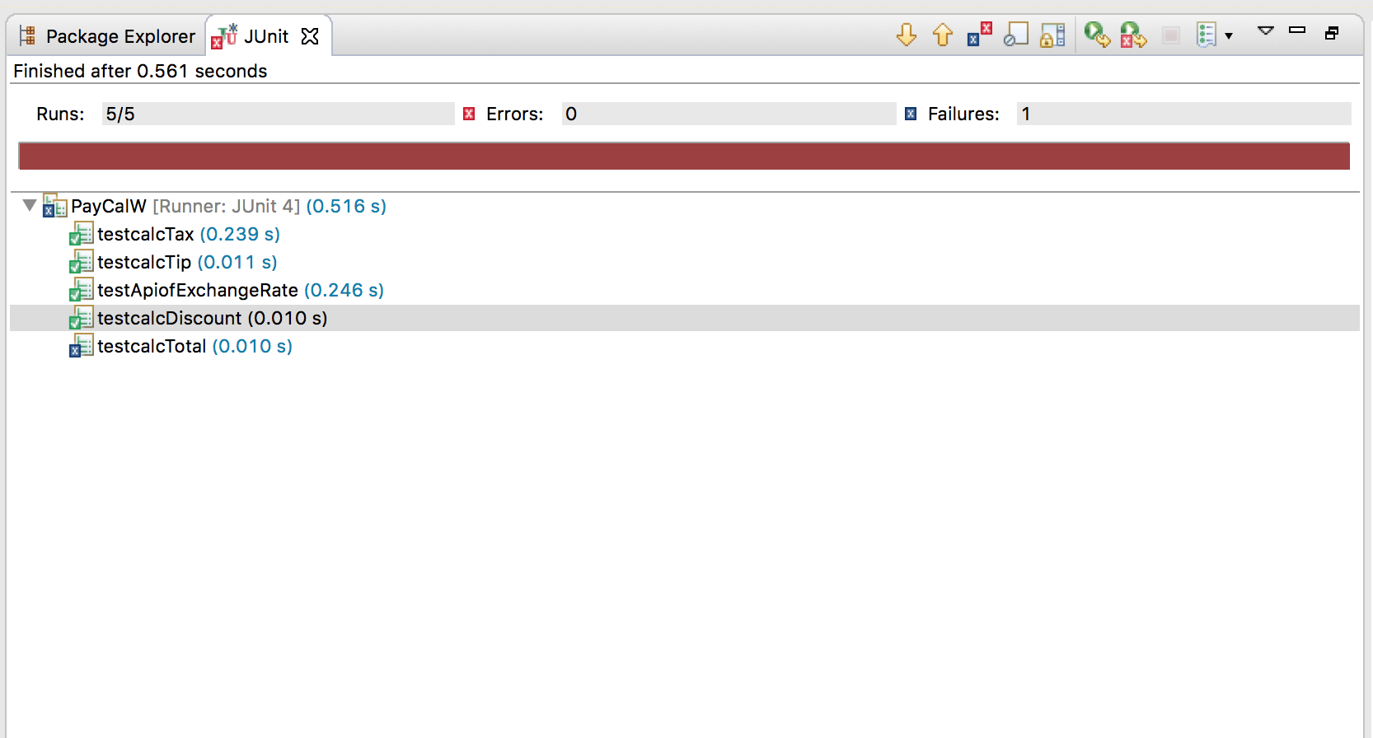
Result of Testcases

Slide 7
JUnit Test cases(Version 4.0)
public void testcalcTax() {
double tax= 10;
double servicePrice = 1000;
PayCalcW pc = new PayCalcW();
System.out.println(pc.calcTax(servicePrice,tax));
Assert.assertTrue(100 == pc.calcTip(servicePrice,tax));
}

Slide 8
Conclusion and Demo of App
Final Payment Calculator is a useful tool for international buyers.
It converts amounts between US Dollars and Saudi Riyals.
It also converts amounts between US Dollars and Euro.
Moreover, the tool can be used to calculate tax, discount, and gratuity.
The implementation of the code has two classes.
A class for designing the interface, and another class implemented to enquire about the current exchange rate.

